Slide 1
Case Study
Sudhanshu Kumar

Slide 2
customer retention
Sudhanshu Kumar

Slide 3
About Us
Customer retention is cheaper than customer acquisition. Here are a few ways to improve your retention strategies.
Businesses work hard to attract customers through a mix of marketing, social media and brand strategies. You have invested a lot of time and effort (and probably money) gaining your customers’ trust. It only makes sense that you want to hold on to them. That is where a strong focus on customer retention comes in handy. To improve customer retention, you have to look at your entire customer experience. The customer experience involves everything customers think and feel when they encounter your brand. Customer-facing interactions, such as support ticket resolution or how a brand communicates its values, are a few factors that can affect a buyer’s relationship with a brand. You will keep more customers by creating a seamless experience that makes them happy every step of the way. However, if your business falls short of customer expectations, you risk losing those customers before you even have a chance to make things right.

Slide 4
What is customer retention?
Customer retention refers to a company’s ability to turn customers into repeat buyers and prevent them from switching to a competitor. It indicates whether your product and the quality of your service please your existing customers. It is also the lifeblood of most subscription-based companies and service providers.
Customer retention strategies are the processes and initiatives businesses put in place to build customer loyalty and improve customer lifetime value.
Customer retention is different from customer acquisition or lead generation. It focuses on customers who have already signed up for a service or purchased a product from you. But retaining customers is about more than just transactions—it is about relationships. Research shows that customers view their relationships with brands similarly to their relationships with friends. Customers like brands that are reliable, authentic and aware of what matters to them. Focus on buyer relationships with your existing customers to boost their brand loyalty. These shoppers will continue to choose your brand even when presented with other options. With this loyal base, your brand will be more likely to weather explosive markets.

Slide 5
Why is customer retention important?
Keeping your current customers happy is generally more cost-effective than acquiring first-time customers. According to the Harvard Business Review, acquiring a new customer can be five to 25 times more expensive than holding on to an existing one.
You do not need to spend big on marketing, advertising or sales outreach. It is easier to turn existing customers into repeating ones, since they already trust your brand from previous purchases. New customers, however, often require more convincing when it comes to that initial sale. Customer loyalty will not just give you repeat business. Loyal customers are more likely to give free recommendations to their colleagues, friends and family. Creating that cycle of retained customers and viral marketing is one way your company can cultivate customer loyalty for long-term success.
Customer retention benefits
Cost savings: Customer retention is generally more cost-effective than acquiring first-time customers
Positive word of mouth marketing: Loyal customers are more likely to tell their friends and family about your brand
A better bottom line: Increasing retention rates by just 5 percent can increase revenue by 25 percent to 95 percent

Slide 6
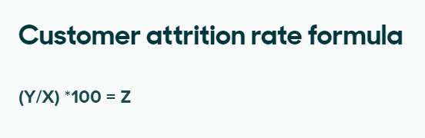
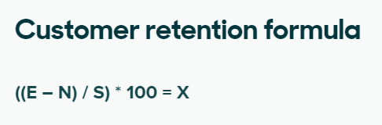
Key customer retention metrics
Customer retention rate
Customer churn rate
Customer lifetime value
The customer retention rate
is the percentage of previous customers who remained loyal to your business over a period
of time. To calculate it, pick a period of time you want to measure and then identify the following:
A less direct indicator of customer retention is your attrition rate—the percentage of customers lost during a period of time. Companies that struggle with customer retention usually have a high attrition rate.
Customer lifetime value measures the total revenue you can expect from a customer, during their lifetime. It helps a business discover its most loyal customers.
Low retention rates or high attrition rates could be bad signs. They may signal that something about your customer experience is not going well. But do not panic—there are several changes you can make to turn the attrition around.
Number of customers at the start of a given time period (S)
Number of customers at the end of that period (E)
Number of new customers added over the duration of that period (N)

Slide 7
strategies to improve customer retention
Deliver fast support
Personalize interactions
Invest in employees
Meet customers where they are
Gather customer feedback
Incentivize loyalty
Incentivize loyalty
Rewarding customer loyalty is a good way to increase customer retention. Customers like it when brands appreciate them and give them reasons to stick around. Strong incentives include loyalty programs, discount codes or special offers. These will motivate customers to continue buying from your business. There are several types of loyalty programs, from points-based systems to tiered rewards. Loyalty programs also help your company collect more detailed customer data. The more purchasing data you have available, the more personalized rewards and offers you can provide to your customers. A loyalty program can not only reward shoppers, but also provide a positive and customized experience based on sales insights. Both components are crucial to customer retention.

Slide 8
Case study
Context
One of the biggest home improvement retailers in US wants to concentrate on retaining its existing customers. They have traditionally been a brick & mortar store but have recently ventured into e-commerce too. This year, they came up with a flat $10 off offer for baskets above $100 (Both in-store & online). They want to have a better directed promotion strategy to counter growing competition next year.
Assumptions
Relevant data is available for the last 10 years.

Slide 9
Problem
Promotion Strategy
You have been tasked with designing their promotion strategy for the next year. How will go about doing this?
Customers
Market gap
66% of US consumers
spend money on multiple products that only partially resolves their issue
Few, if any, products on the market help customers like we do​

Slide 10




Solution
Customer insight
Applying RFM(Segmentation)
Customer Profiling
Applying Promotion
Customer insights involve gaining deep understanding of customer behavior, preferences, and needs to inform business decisions and enhance customer experiences.
RFM stands for Recency, Frequency, and Monetary Value. It is a marketing analysis technique used to segment customers based on their purchasing behavior.
The process of understanding and categorizing your target customers based on their characteristics, behaviors, and preferences to tailor marketing strategies and deliver products and services that meet their needs.
Applying promotions based on customer profiles involves offering targeted promotions and discounts tailored to specific customer characteristics and preferences for increased engagement and sales.

Slide 11
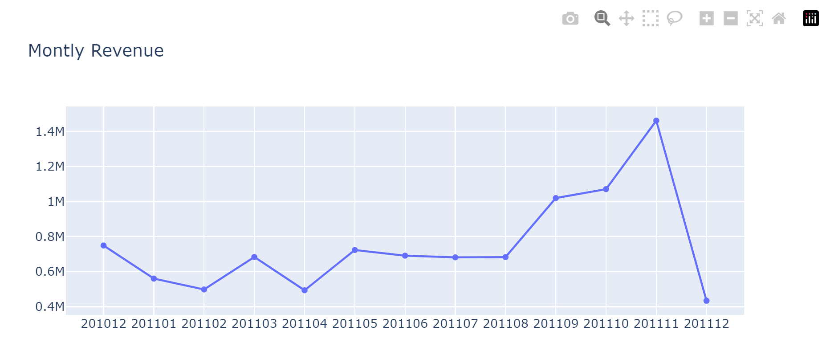
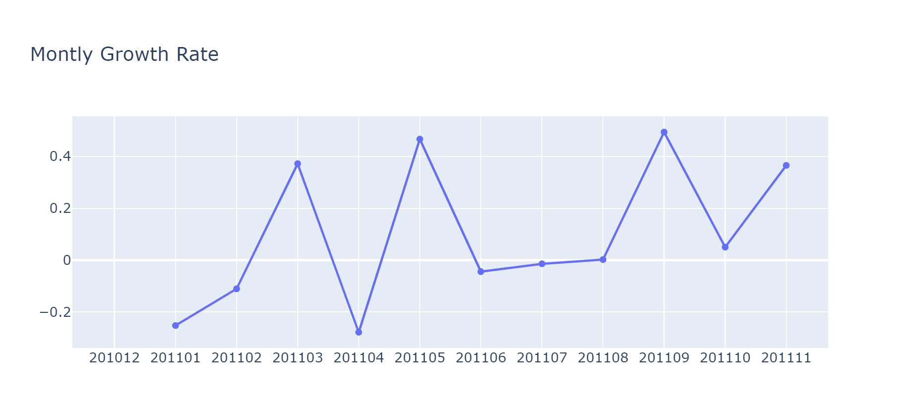
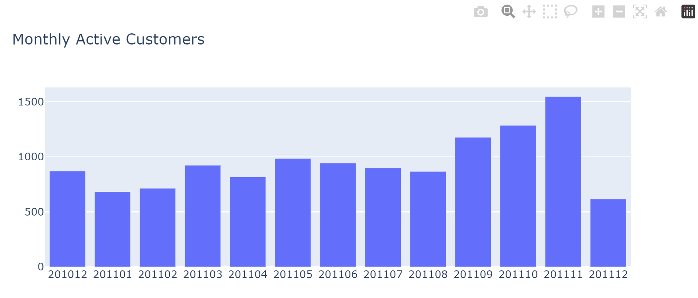
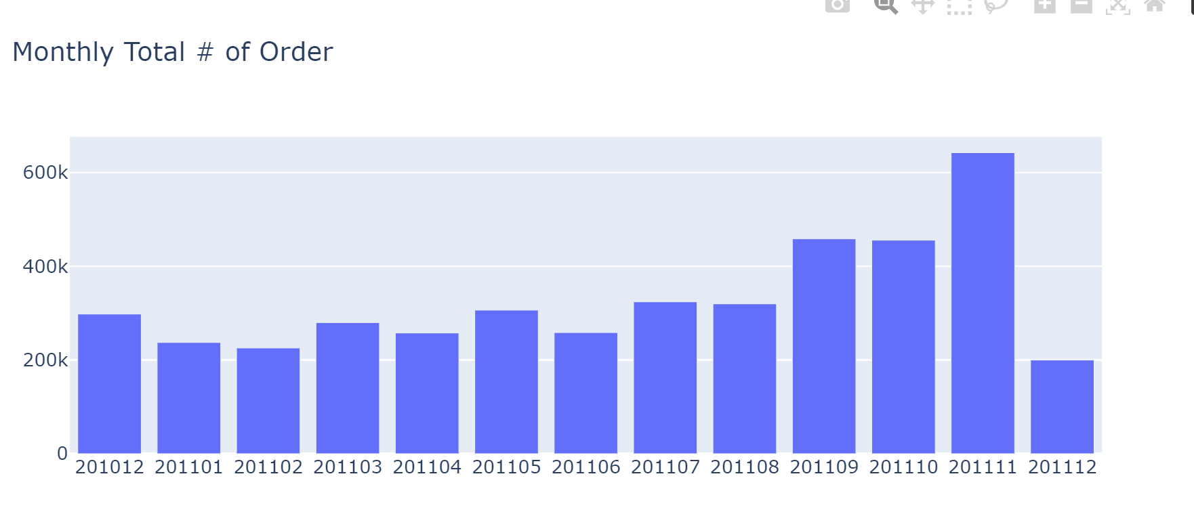
Monthly Revenue & Growth

Slide 12
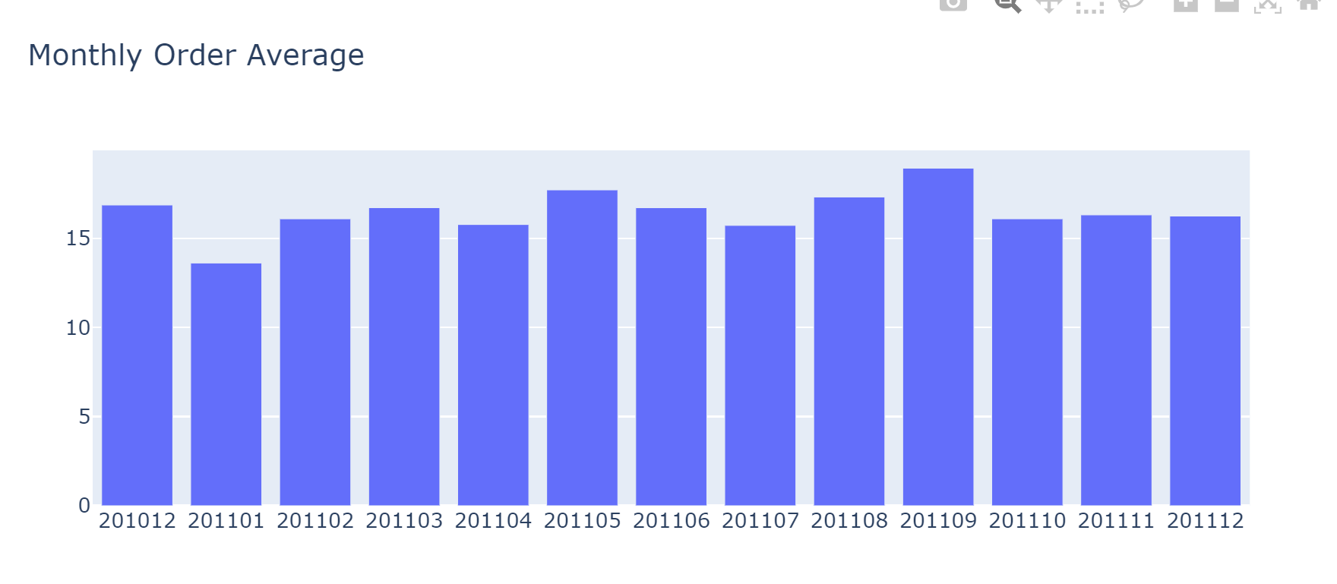
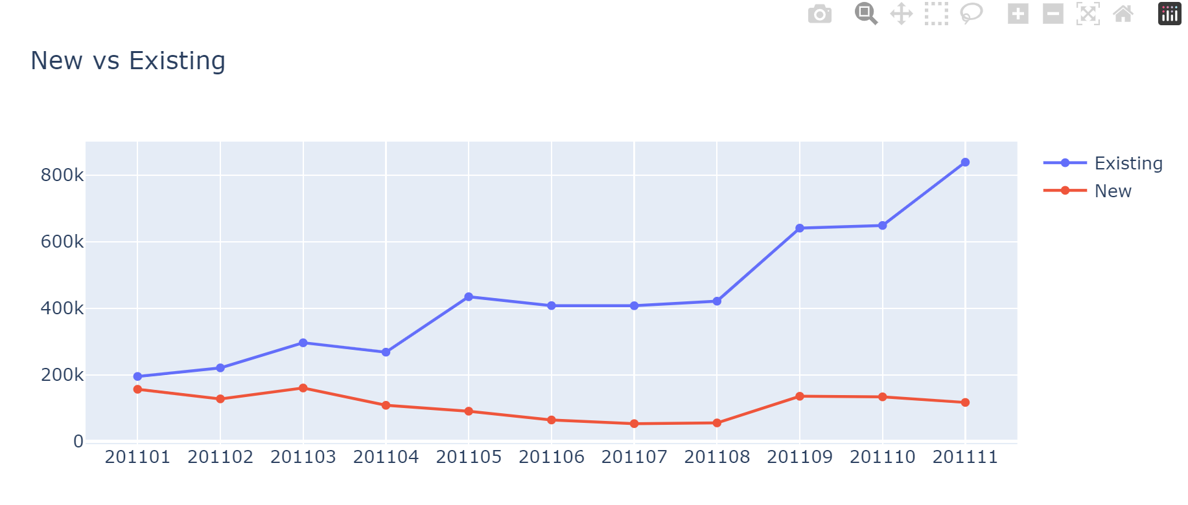
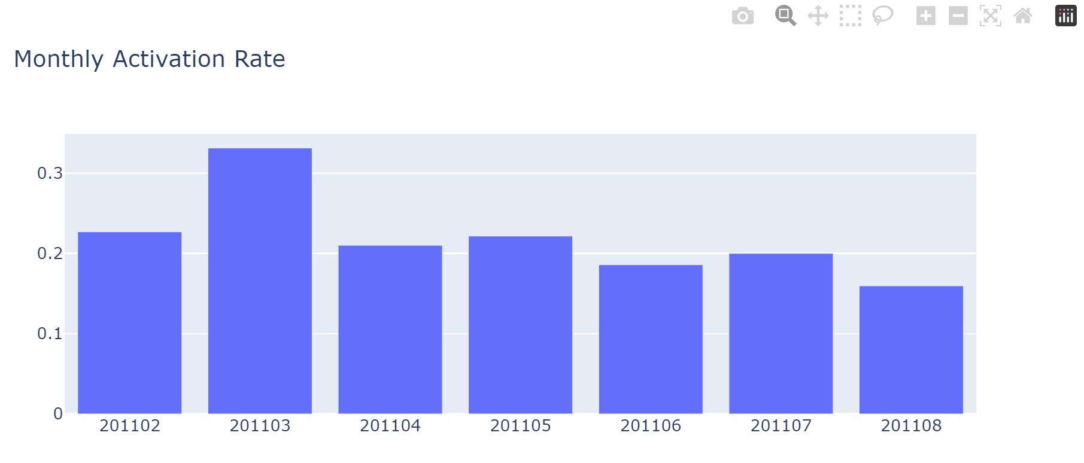
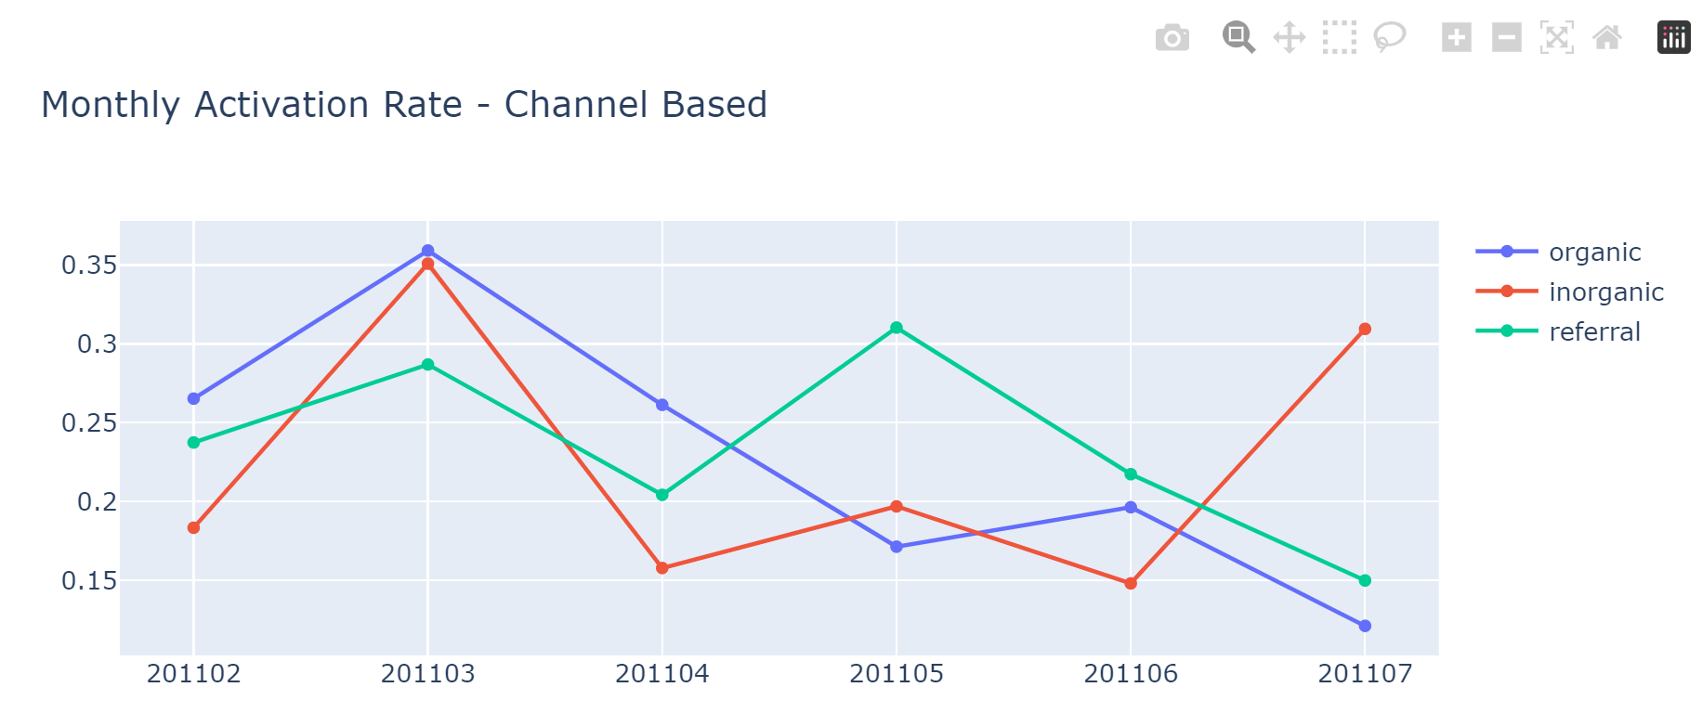
Monthly Orders & new users

Slide 13
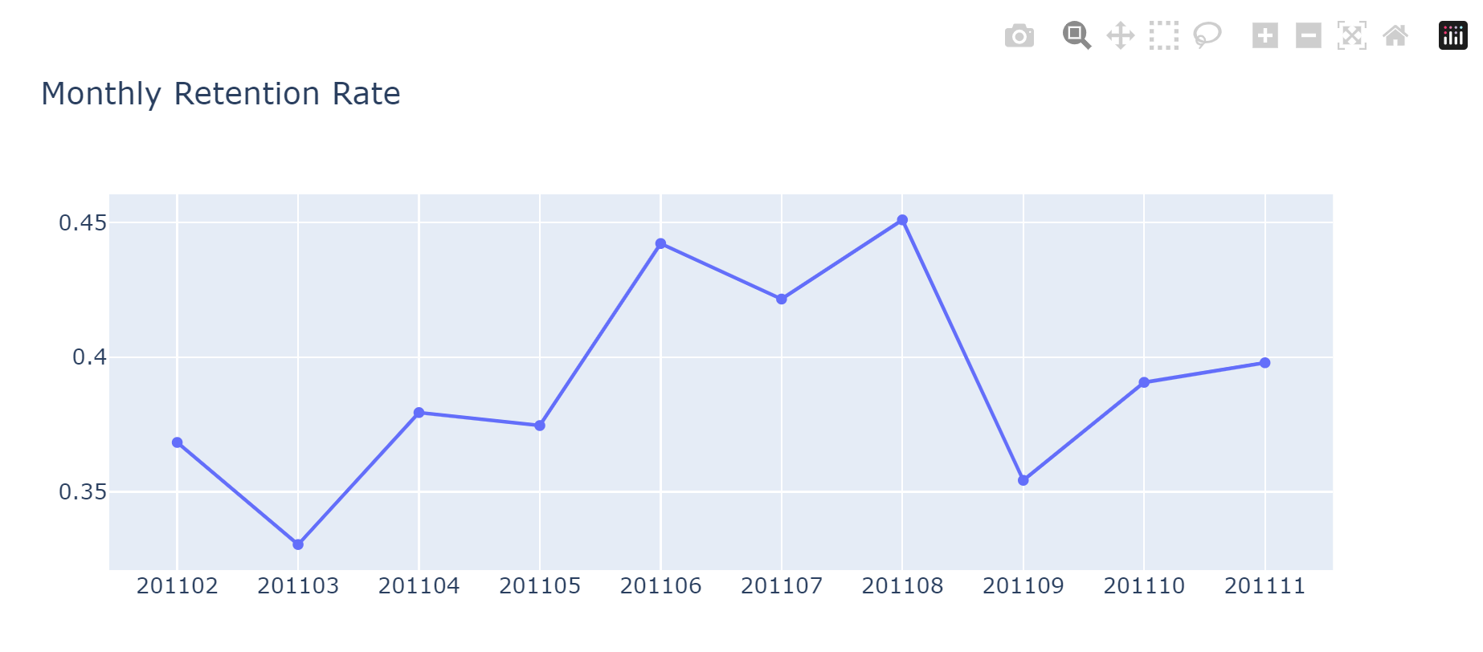
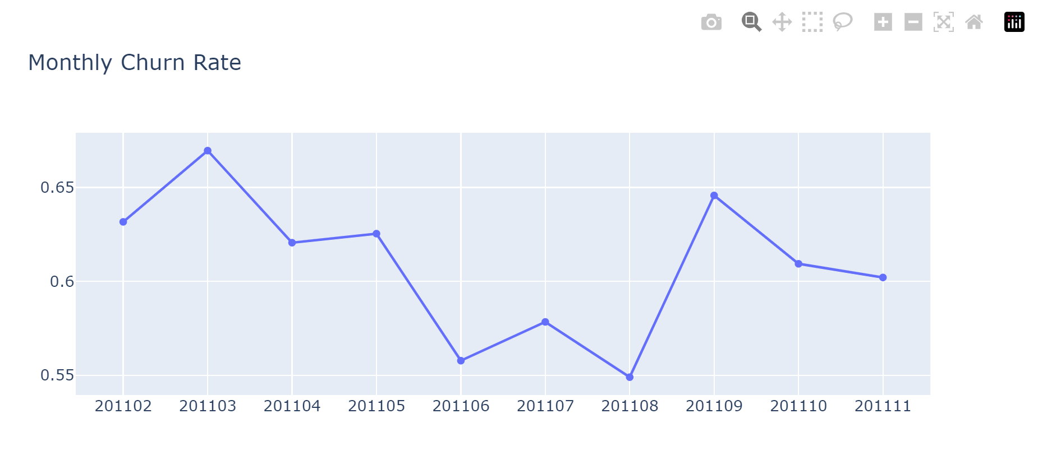
Monthly

Slide 14
RFM

Slide 15
RFM(Recency, Frequency, Monetary Value)
Recency, frequency, monetary value is a marketing analysis tool used to identify a company's or an organization's best customers by using certain measures. The RFM model is based on three quantitative factors:
Recency: How recently a customer has made a purchase.
Frequency: How often a customer makes a purchase.
Monetary Value: How much money a customer spends on purchases.
RFM analysis numerically ranks a customer in each of these three categories, generally on a scale of 1 to 5 (the higher the number, the better the result). The "best" customer would receive a top score in every category.
Understanding Recency, Frequency, Monetary Value (RFM) The concept of recency, frequency, monetary value (RFM) is thought to date from an article by Jan Roelf Bult and Tom Wans Beek, "Optimal Selection for Direct Mail," published in a 1995 issue of Marketing Science. RFM analysis often supports the marketing adage that "80% of business comes from 20% of the customers."

Slide 16
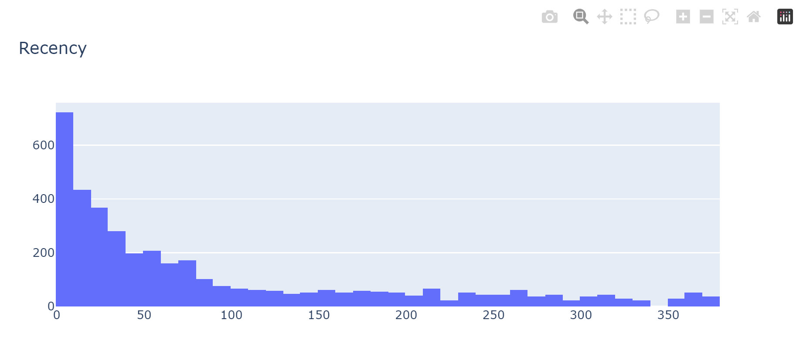
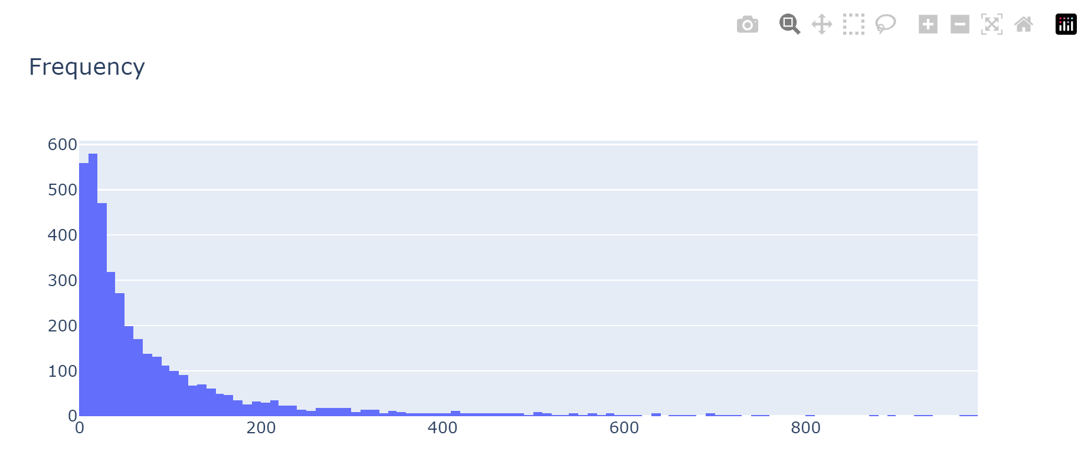
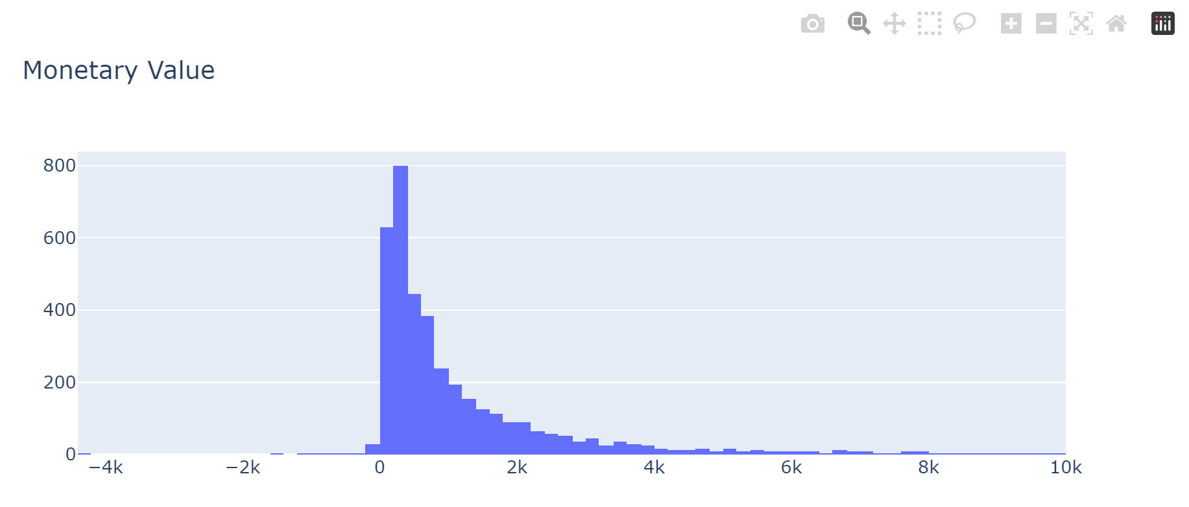
Recency, Frequency, Monetary Value

Slide 17
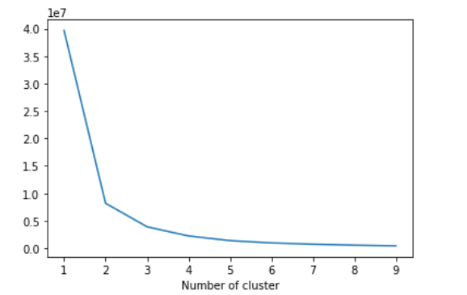
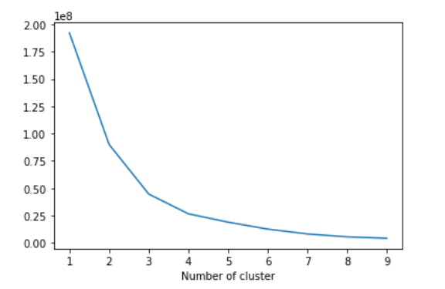
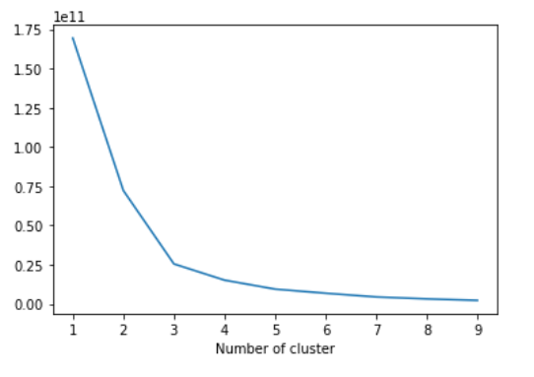
Clustering Model on RFM data
Recency data
Frequency data
Revenue(monetary values) data

Slide 18
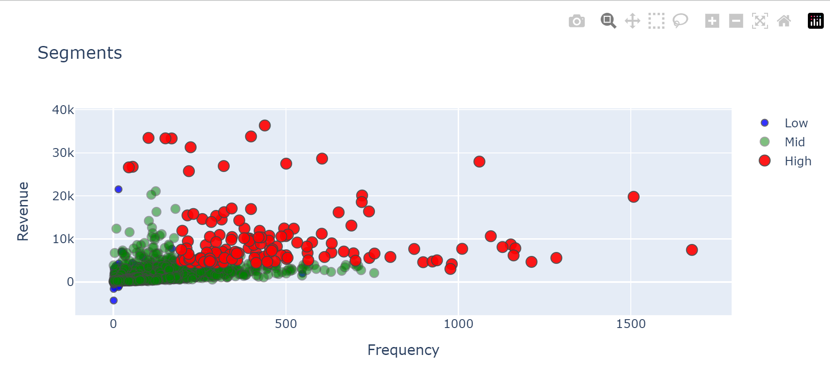
customer profiling(Segments)

Slide 19
Summary
RFM (Recency, Frequency, Monetary) analysis and cluster machine learning techniques, customer profiling was performed for the retail store. The RFM analysis helped identify the most valuable customers based on their recency of purchase, frequency of purchases, and monetary value spent. By segmenting customers into distinct clusters, meaningful patterns and insights were derived regarding their behavior.
This customer profiling exercise provided valuable information about customer segmentation, allowing the retail store to understand different groups of customers and their unique preferences. By leveraging this knowledge, the store can tailor its marketing strategies and pricing decisions to cater to each customer segment effectively.
Overall, the combination of RFM analysis and cluster machine learning techniques has empowered the retail store to make data-driven decisions, optimizing their marketing efforts and enhancing customer satisfaction.

Slide 20
Thank you
Sudhanshu Kumar
+91-7488078452
sudhanshukrmfp@gmail.com​

